Slide 1
CS 463 Natural Language Processing
Dr. Saleh Haridy
2023-2024

Slide 2
Week 2
Regular Expressions,
Text Normalization,

Slide 3
Outline
Regular expressions
Basic RegExp patterns, Disjunction, grouping and precedence
Example using RE python library
Words
Lemma, wordform, wordtype, token
Corpora
Text Normalization
Word Tokenization
Word Normalization, Lemmatization, stemming
Sentence segmentation

Slide 4
ELIZA chatbot in 1966
User: I am unhappy.
ELIZA: DO YOU THINK COMING HERE WILL HELP YOU NOT TO BE UNHAPPY
User: I need some help, that much seems certain.
ELIZA: WHAT WOULD IT MEAN TO YOU IF YOU GOT SOME HELP
User: Perhaps I could learn to get along with my mother.
ELIZA: TELL ME MORE ABOUT YOUR FAMILY
User: My mother takes care of me.
ELIZA: WHO ELSE IN YOU FAMILY TAKES CARE OF YOU
User: My father.
ELIZA: YOUR FATHER
User: You are like my father in some ways.
The dialogue above is from ELIZA, an early natural language processing system that could carry on a limited conversation with a user by developed at MIT in 1966.
ELIZA is a surprisingly simple program that uses pattern matching to recognize phrases like “I need X” and translate them into suitable outputs like “What would it mean to you if you got X?”.
http://psych.fullerton.edu/mbirnbaum/psych101/eliza.htm\

Slide 5
Regular Expressions (RE)
A language for specifying text search strings.
RE is an algebraic notation for characterizing a set of strings.
Regular expressions can be used to search for a string in a text or corpus of texts such as find strings like $199 or $24.99 for extracting tables of prices from a document.
the Unix command-line tool grep takes a regular expression and returns every line of the input document that matches the expression
Python has a built-in library called re, which can be used for Regular expressions
https://www.w3schools.com/python/python_regex.asp

Slide 6

Basic Regular Expression Patterns
The simplest kind of regular expression is a sequence of simple characters.
import re
txt = "interesting links to woodchucks"
x = re.search("woodchucks", txt)
print(x.group())
['woodchucks']
Python Online IDE:
https://replit.com/languages/python3

Slide 7
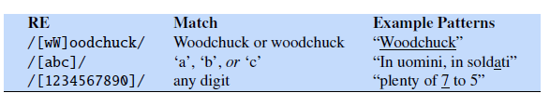
Basic Regular Expression Patterns
Regular expressions are case sensitive; lower case /s/ is distinct from upper case /S/
This means that the pattern /woodchucks/ will not match the string Woodchucks. We can solve this problem with the use of the square braces [ ].
The string of characters inside the braces specifies a disjunction (OR) of characters to match, /[wW]/ matches patterns containing either w or W.
The regular expression /[1234567890]/ specifies any single digit.

Slide 8
Regular Expression (range)
In cases where there is a well-defined sequence associated with a set of characters, the brackets can be used with the dash (-) to specify range any one character in a range. The pattern /[2-5]/ specifies any one of the characters 2, 3, 4, or 5. The pattern /[b-g]/ specifies one of the characters b, c, d, e, f, or g.

Slide 9
Regular Expression (negation)
The square braces can also be used to specify what a single character cannot be, by use of the caret ^. If the caret ^ is the first symbol after the open square brace [, the resulting pattern is negated
For example, the pattern /[^a]/ matches any single character (including special characters) except a.
This is only true when the caret is the first symbol after the open square brace. If it occurs anywhere else, it usually stands for a caret

Slide 10
Regular Expression (optionality)
How can we talk about optional elements, like an optional s in woodchuck and woodchucks? We can’t use the square brackets, because while they allow us to say “s or S”, they don’t allow us to say “s or nothing”
we use the question mark /?/, which means “the preceding character or nothing”,

Slide 11
Regular Expression (Kleene *)
baa!
baaa!
baaaa!
baaaaa!
These words consists of strings with letter b, followed by at least two a’s, followed by an exclamation point.
The set of operators that allows us to say things like “some Kleene * number of as” are based on the asterisk or *,
The Kleene star means “zero or more occurrences of the immediately previous character or regular expression
Meaning | RE
Any string of zero or more a | /a*/
one a followed by zero or more as | /aa*/
zero or more a’s or b’s | /[ab]*/
An integer (a string of digits) is | /*[0-9][0-9] /

Slide 12
Regular Expression (Kleene +)
Kleene +, means “one or more occurrences of the immediately preceding character or regular expression”.
The expression /[0-9]+/ is the normal way to specify “a sequence of digits”.
One very important special character is the period (/./), a wildcard expression that matches any single character

Slide 13
Regular Expression (anchors ^ $)
Anchors are special characters that anchor regular expressions to particular places in a string.
the caret ^ has three uses: to match the start of a line, to indicate a negation inside of square brackets, and just to mean a caret
Meaning | RE
matches the word The only at the start of a line. | ^The/
match a . at the end of a line | \.$
matches a line that contains only the phrase The dog. | /^The dog\.$/
matches the word the but not the word other | /\bthe\b/
match the string 99 in There are 99 bottles of beer on | /\b99\b

Slide 14
Disjunction “|”, Grouping, and Precedence
Suppose we need to search for texts about cats and dogs. We can’t use/[catdog]/)
The disjunction operator (the pipe |) can be used. The pattern /cat|dog/ matches either the string cat or the string dog.
Pattern | Matches
groundhog|woodchuck | woodchuck
yours|mine | yours
a|b|c | = [abc]
[gG]roundhog|[Ww]oodchuck | Woodchuck

Slide 15
Substitutions
Substitution in Python
re.sub(patern, repl, string, count=0, flags=0)
pattern – the pattern which is to be searched and substituted
repl – the string with which the pattern is to be replaced
string – the name of the variable in which the pattern is stored
count – number of characters up to which substitution will be performed
flags – it is used to modify the meaning of the regex pattern
count and flags are optional arguments.
import re
sentence1 = "It is raining outside."
re.sub(r"raining", "sunny", sentence1)
It is sunny outside.
Notes:
The syntax for substitutions is simple. For example the python "S" command can be used to change a string matched by a regex to the substitute, another string.

Slide 16
Capture Groups
It is often useful to be able to refer to a particular subpart of the string matching the first pattern. For that, we can use "capture groups", a way of storing part of the pattern into a "register" so we can refer to it later in the substitution string.
Say we want to put angles around all numbers:
the 35 boxes → the <35> boxes
Use parens () to "capture" a pattern into a numbered register (1, 2, 3…)
Use \1 to refer to the contents of the register
s/([0-9]+)/<\1>/
Notes:
It is often useful to be able to refer to a particular subpart of the string matching the first pattern. For that, we can use "capture groups", a way of storing part of the pattern into a "register" so we can refer to it later in the substitution string.

Slide 17
Capture groups: multiple registers
import re
mon = re.search(r'(\d{4})-(\d{2})-(\d{2})', '2018-09-01')
print(mon.groups())
print(mon.group())
print(mon.group(1))
print(mon.group(2))
print(mon.group(3))
('2018', '09', '01')
2018-09-01
2018
09
01
# substitute with group reference
import re
date = r'2018-09-01'
re.sub(r'(\d{4})-(\d{2})-(\d{2})',r'\2/\3/\1/',date)
'09/01/2018/'
Notes:
In very complex patterns, we'll want to use more than one register; here's an example where we first capture two strings, and then refer to them both in order.

Slide 18
But suppose we don't want to capture?
Parentheses have a double function: grouping terms, and capturing
Non-capturing groups: add a ?: after paren:
/(?:some|a few) (people|cats) like some \1/
matches
some cats like some cats
but not
some cats like some some
sen = 'some cats like some cats'
mon = re.search(r'(?:some|a few) (people|cats) like some \1', sen)
mon.groups()
('cats',)
Notes:
Here's a problem: parenthesis are used to specify capture groups. But they are also how we group terms, for example for disjunctions, like an expression for a string matching "people" or "cats". How do we specify that we are using the capture groups just for grouping and not for capturing? We simply add a "question mark colon" after the open paren.

Slide 19
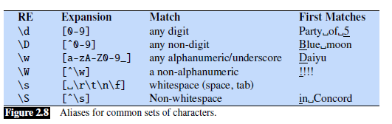
More Operators

Slide 20
Example
Assume we want to find all instances of the word “the” in a text.
the
This will miss the word (The)
capitalized examples
[tT]he
But it Incorrectly returns other or theology
[^a-zA-Z][tT]he[^a-zA-Z]

Slide 21
Errors
The process we just went through in previous example was based on fixing two kinds of errors:
Matching strings that we should not have matched (there, then, other)
False positives (Type I errors)
Not matching things that we should have matched (The)
False negatives (Type II errors)

Slide 22
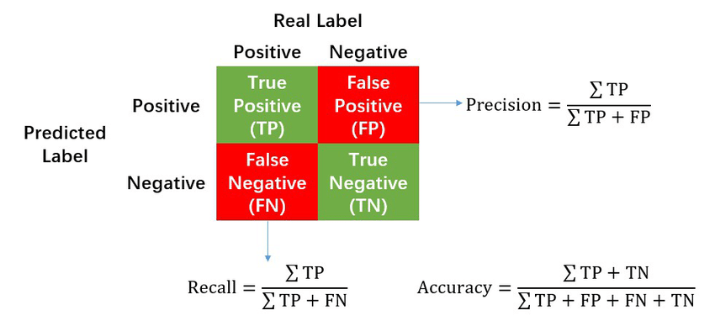
Errors cont.
In NLP we are always dealing with these kinds of errors.
Reducing the error rate for an application often involves two antagonistic efforts:
Increasing precision (minimizing false positives)
Increasing recall (minimizing false negatives).

Slide 23
Simple Application: ELIZA
Early NLP system that imitated a Rogerian psychotherapist Joseph Weizenbaum, 1966.
Uses pattern matching to match, e.g.,:
“I need X”
and translates them into, e.g.
“What would it mean to you if you got X?
Notes:
Substitutions and capture groups are very useful in implementing simple chat-bots like ELIZA. ELIZA , one of the most important historical NLP systems, was created by pioneering AI researcher Joseph Weizenbaum in 1966, and simulates a Rogerian psychologist, a kind of therapist who emphasizes mirroring back what they hear. ELIZA is a surprisingly simple program that uses pattern matching to recognize phrases like “I need X” and translate them into suitable outputs like “What would it mean to you if you got X?”. This simple technique succeeds in this domain because ELIZA doesn’t actually need to know anything to mimic a Rogerian psychotherapist. This is one of the few dialogue genres where listeners can act as if they know nothing of the world.

Slide 24
Simple Application: ELIZA
Men are all alike. IN WHAT WAY
They're always bugging us about something or other. CAN YOU THINK OF A SPECIFIC EXAMPLE
Well, my boyfriend made me come here. YOUR BOYFRIEND MADE YOU COME HERE
He says I'm depressed much of the time. I AM SORRY TO HEAR YOU ARE DEPRESSED
Notes:
Here's some fragments from a sample conversation with ELIZA in 1966. Eliza’s mimicry of human conversation was remarkably successful: many people who interacted with ELIZA came to believe that it really understood them and their problems, and in very prescient early work, Weizenbaum pointed out the ethical issues in this attribution of human qualities to an artificial agent. We'll return to this issue in the dialogue lectures.

Slide 25
How ELIZA (chatbot) works
s/.* I’M (depressed|sad) .*/I AM SORRY TO HEAR YOU ARE \1/
s/.* I AM (depressed|sad) .*/WHY DO YOU THINK YOU ARE \1/
s/.* all .*/IN WHAT WAY?/
s/.* always .*/CAN YOU THINK OF A SPECIFIC EXAMPLE?/
Q=r"Hi, I'M sad"
A=re.sub(r".* I'M (depressed|sad)",r'I AM SORRY TO HEAR YOU ARE \1',Q)
'I AM SORRY TO HEAR YOU ARE sad'
Notes:
ELIZA consists mainly of a series of substitution patterns, with some control for deciding what pattern to select, and some higher-level dialogue structure that we'll come back to. Here we can see examples of capture groups for capturing the adjectives the user writes to describes themselves, and simple patterns for asking more details when the user uses generic statements containing "all" or "always".

Slide 26
Regular expressions Summary
Regular expressions play a surprisingly large role
Sophisticated sequences of regular expressions are often the first model for any text processing text
For hard tasks, we use machine learning classifiers
But regular expressions are still used for pre-processing, or as features in the classifiers
Can be very useful in capturing generalizations

Slide 27
How many words in a sentence?
"I do uh main- mainly business data processing"
Fragments, filled pauses
"Seuss’s cat in the hat is different from other cats!"
Lemma: Two words are the same lemma if they have the same stem, the same part of speech, the same sense
cat and cats = same lemma
Wordform: the exact surface form of the word, with all its inflections or endings
cat and cats = different wordforms
Notes:
Let's start by asking how many words are in just one sentence? Here's a sentence: "I do uh main- mainly business data processing". How many words are in that sentence? It's a complicated question. Is "uh" a word? What about the cutoff "main" the first time I started to say "mainly". We call things like "main" here a fragment, and we call "uh" and "um" filled pauses. So for certain applications, like speech applications, we might want to be counting these. Or how about "cat" and "cats" in this Dr. Seuss sentence? It will help to introduce the distinction between "lemma" and "wordform". Two words are the same lemma if they have the same stem, the same part of speech, the same sense. Whereas wordform is the exact surface form of the word, with all its inflections or endings. So if we're counting lemmas, "cat" and "cats" count as the same lemma. If we're counting wordforms, "cat" and "cats" are different.

Slide 28
How many words in a sentence?
they lay back on the San Francisco grass and looked at the stars and their
It depends how you count. We could count word types, the number of unique words that occur in the sentence
By that count we only count "the" once, even though it appears twice.
Type: an element of the vocabulary.
Token: an instance of that type in running text.
How many?
15 tokens (or 14)
13 types (or 12) (or 11?)
Notes:
Let's look at a part of another sentence. How many words are in this sentence? Pause the video and count for yourself. Again, it depends how you count. We could count word types, the number of unique words that occur in the sentence. By that count we only count "the" once, even though it appears twice. Word tokens we're counting every word token on the page, so the two "the"s count twice. And what about San Francisco? One word or two? And how about "they and their". Different wordforms, same lemma. Again, it depends on our goals, and it's important to make that clear whenever you report word counts

Slide 29
How many words in a corpus?
N = number of tokens
V = vocabulary = set of types, |V\ is size of vocabulary
Heaps Law = Herdan's Law = where often .67 < β < .75
i.e., vocabulary size grows with > square root of the number of word tokens
 | Tokens = N | Types = |V|
Switchboard phone conversations | 2.4 million | 20 thousand
Shakespeare | 884,000 | 31 thousand
COCA | 440 million | 2 million
Google N-grams | 1 trillion | 13+ million
Types are the number of distinct words in a corpus;
Tokens are the total number N of running words
Notes:
In general, we'll refer to the number of tokens with capital N. And we'll use capital V to mean the vocabulary, the set of all words. So the cardinality of V is the size of vocabulary, the number of word types. although sometimes for simplification, we'll just use capital V to mean the vocabulary size when it's not ambiguous. There's a relationship between these two in running text, called Heaps Law or Herdan's Law, which is that the size of the vocabulary grows with spmething over the square root of the number of word tokens. So a large corpus of N words tokens, you can expect to see N to the .7 word types. Here are the numbers for some common corpora,… The switchboard corpus of phone conversations has 2.4 million word tokens. And there's 20,000 word types in those 2.4
millions words. Shakespeare has just under a million word tokens. Shakespeare is
quite a small corpus. He wrote, 800,000 words in his lifetime. And in that less
than a million words, he actually used 31,000 distinct words. So he had a very,
very broad vocabulary famously. And if you look at a very huge corpus, the Google
N-grams corpus that has a trillion different tokens, a very large number of
words, there's. Thirteen million types, so how many words are there in English? Well,
if you look at conversation, 20,000 different words. If you look at
Shakespeare, 30,000 words. And if you combine the two, probably somewhere, not
quite the sum of the two, but some larger number. But if you look at the Google
engrams, we have thirteen million. And of course, some of those are probably urls,
and. And email addresses, but even if you eliminate all of those, the number of
words in a language is very large, maybe there's a million words of English.

Slide 30
Corpora (text datasets)
A text corpus is a large body of text. Many corpora are designed to contain a careful balance of material in one or more genres.
Words don't appear out of nowhere!
A text is produced by
a specific writer(s),
at a specific time,
in a specific variety,
of a specific language,
for a specific function.
Notes:
Where did these corpora come from? …. These characteristics of a text influence properties of the text.

Slide 31
Corpora vary along dimension like
Language: 7097 languages in the world
Variety, like African American Language varieties.
AAE Twitter posts might include forms like "iont" (I don't)
Code switching, e.g., Spanish/English, Hindi/English:
S/E: Por primera vez veo a @username actually being hateful! It was beautiful:)
[For the first time I get to see @username actually being hateful! it was beautiful:) ]
H/E: dost tha or ra- hega ... dont wory ... but dherya rakhe
[“he was and will remain a friend ... don’t worry ... but have faith”]
Genre: newswire, fiction, scientific articles, Wikipedia
Author Demographics: writer's age, gender, ethnicity, SES
Notes:
For example, what language is the text in? As we'll see when we get to talking about word tokenization, what counts as a word can be different in different languages.

Slide 32
Corpus datasheets
Motivation:
Why was the corpus collected?
By whom?
Who funded it?
Situation: In what situation was the text written?
Collection process: If it is a subsample how was it sampled? Was there consent? Pre-processing?
+Annotation process, language variety, demographics, etc.
Notes:
You'll need to make sure you consider all those properties of a text when you are using it for processing purposes. And there are even more properties of corpora that it's important to consider. Who collected this corpus?
Whenever you build a corpus, you should be documenting these decisions in a datasheet for the corpus.

Slide 33
Text Normalization
Every NLP task requires text normalization:
Tokenizing (segmenting) words
Normalizing word formats
Segmenting sentences

Slide 34
Space-based tokenization
A very simple way to tokenize
For languages that use space characters between words
Arabic, Cyrillic, Greek, Latin, etc., based writing systems
Segment off a token between instances of spaces
Unix tools for space-based tokenization
The "tr" command in Unix
Given a text file, output the word tokens and their frequencies
Python tools for space-based tokenization
split method for string
findall method in re library
…
Notes:
Let's now introduce some simple Unix tools for text processing, starting with the UNIX "tr" command for space-based word tokenization. Our goal will be to take a text file and output word tokens and their frequencies.

Slide 35
Simple Tokenization in Python
text = """ Tokenization is a common task a data scientist comes across when working with text data. It consists of splitting an entire text into small units, also known as tokens. Most Natural Language Processing (NLP) projects have tokenization as the first step because it's the foundation for developing good models and helps better understand the text we have."""
# use split
text.split()
#tokenize the text with regular expressions
token=re.findall('\w+', text)
token[:10]
['Tokenization', 'is', 'a', 'common', 'task', 'a', 'data', 'scientist', 'comes', 'across', 'when', 'working',

Slide 36
Simple Tokenization in Python
# convert to lowercase
for word in token:
words.append(word.lower())
words[:10]
# dowload stopwords modile
import nltk
nltk.download("stopwords")
sw=nltk.corpus.stopwords.words('english')
sw[:5]
# get the list without stop words
words_ne=[]
for word in words:
if word not in sw:
words_ne.append(word)
words_ne=sorted(words_ne)
words_ne[:5]
['across', 'also', 'better', 'comes', 'common']

Slide 37
Issues in Tokenization
Can't just blindly remove punctuation:
m.p.h., Ph.D., AT&T, cap’n
prices ($45.55)
dates (01/02/06)
URLs (http://www.stanford.edu)
hashtags (#nlproc)
email addresses (someone@cs.colorado.edu)
Clitic: a word that doesn't stand on its own
"are" in we're, French "je" in j'ai, "le" in l'honneur
When should multiword expressions (MWE) be words?
New York, Kingdom of Sauid Arabia
Notes:
Of course, tokenization in most real situations isn't as simple as I've suggested with the simple UNIX tools.

Slide 38
Tokenization in NLTK
Bird, Loper and Klein (2009), Natural Language Processing with Python. O’Reilly
text = 'That U.S.A. poster-print costs $12.40...'
pattern = r'''(?x) # set flag to allow verbose regexps
(?:[A-Z]\.)+ # abbreviations, e.g. U.S.A.
| \w+(?:-\w+)* # words with optional internal hyphens
| \$?\d+(?:\.\d+)?%? # currency and percentages, e.g. $12.40, 82%
| \.\.\. # ellipsis
| [][.,;"'?():-_`] # these are separate tokens; includes ], [
'''
nltk.regexp_tokenize(text, pattern)
['That', 'U.S.A.', 'poster-print', 'costs', '$12.40', '...']
The special (?x) "verbose flag" tells Python to strip out the embedded whitespace and comments.
Notes:
So most standard tokenization programs for English or languages with similar writing systems need to deal with each of these issues. Here's a simple python tokenizer in the Natural Language Toolkit that has little regular expressions for dealing with hypthens, and currency, and whatnot

Slide 39
Another option for text tokenization
Instead of
white-space segmentation
single-character segmentation
Use the data to tell us how to tokenize.
Subword tokenization (because tokens can be parts of words as well as whole words)

Slide 40
Subword tokenization
Three common algorithms:
Byte-Pair Encoding (BPE) (Sennrich et al., 2016)
Unigram language modeling tokenization (Kudo, 2018)
WordPiece (Schuster and Nakajima, 2012)
All have 2 parts:
A token learner that takes a raw training corpus and induces a vocabulary (a set of tokens).
A token segmenter that takes a raw test sentence and tokenizes it according to that vocabulary

Slide 41
Byte Pair Encoding (BPE) token learner
Let vocabulary be the set of all individual characters
= {A, B, C, D,…, a, b, c, d….}
Repeat:
Choose the two symbols that are most frequently adjacent in the training corpus (say 'A', 'B')
Add a new merged symbol 'AB' to the vocabulary
Replace every adjacent 'A' 'B' in the corpus with 'AB'.
Until k merges have been done.

Slide 42
BPE token learner algorithm

Slide 43
Byte Pair Encoding (BPE)
Most subword algorithms are run inside space-separated tokens.
So we commonly first add a special end-of-word symbol '__' before space in training corpus
Next, separate into letters.

Slide 44
BPE token learner
Original (very fascinating🙄) corpus:
low low low low low lowest lowest newer newer newer newer newer newer wider wider wider new new
Add end-of-word tokens, resulting in this vocabulary:
representation

Slide 45
BPE token learner
Merge e r to er

Slide 46
BPE
Merge er _ to er_

Slide 47
BPE
Merge n e to ne

Slide 48
BPE
The next merges are:

Slide 49
BPE token segmenter algorithm
On the test data, run each merge learned from the training data:
Greedily
In the order we learned them
(test frequencies don't play a role)
So: merge every e r to er, then merge er _ to er_, etc.
Test = ‘ newer- low er-’
Result:
Test set "n e w e r _" would be tokenized as a full word
Test set "l o w e r _" would be two tokens: "low er_"

Slide 50
Properties of BPE tokens
Usually include frequent words
And frequent subwords
Which are often morphemes like -est or –er
A morpheme is the smallest meaning-bearing unit of a language
unlikeliest has 3 morphemes un-, likely, and -est
Implementation of BPE
https://huggingface.co/course/chapter6/5?fw=pt

Slide 51
Word Normalization
Putting words/tokens in a standard format
U.S.A. or USA or US -> USA
uhhuh or uh-huh
Fed or fed
am, is, be, are -> be
KSA, Saudi Arabia, Kingdom of Saudi Arabia > Saudia
…
For information retrieval (IR) or information extraction about the US, we might want to see information from documents whether they mention the US or the USA.
Notes:
Information extraction (IE) is the task of automatically extracting structured information from unstructured and/or semi-structured machine-readable documents, whereas information retrieval (IR) is the task of using queries to locate material (usually documents) of an unstructured nature (usually text) that meets an information need from large collections (usually stored on computers).

Slide 52
Case folding
Applications like IR: reduce all letters to lower case
Since users tend to use lower case
For sentiment analysis, MT, Information extraction
Case is helpful (US versus us is important)
For many natural language processing situations we also want two morphologically different forms of a word to behave similarly

Slide 53
Lemmatization
Lemmatization is the task of determining that two words have the same root, despite their surface differences.
Represent all words as their lemma, their shared root
= dictionary headword form:
am, are, is → be
car, cars, car's, cars' → car
Arabic: كتب – يكتب – كتبوا – مكتبه – كتاب – كاتب -
He is reading detective stories
→ He be read detective story

Slide 54
Lemmatization is done by Morphological Parsing
Morphemes:
The small meaningful units that make up words consists of two classes:
Stems: The core meaning-bearing units
Affixes: Parts that adhere to stems, often with grammatical functions
Morphological Parsers:
Parse cats into two morphemes cat and s
In Arabic : وسيكتبون (وس- يكتب - ون)
Stem: يكتب
Lemma: كتب
Lemmatization algorithms can be complex and we use stemming.

Slide 55
Stemming
Reduce terms to stems, chopping off affixes crudely
This was not the map we found in Billy Bones’s chest, but an accurate copy, complete in all things-names and heights and soundings-with the single exception of the red crosses and the written notes.
Thi wa not the map we found in Billi Bone s chest but an accur copi complet in all thing name and height and sound with the singl except of the red cross and the written note
.
Notes:
Stemming - Stemming is a process of reducing words to its root form even if the root has no dictionary meaning. For eg: beautiful and beautifully will be stemmed to beauti which has no meaning in English dictionary.
Lemmatisation - Lemmatisation is a process of reducing words into their lemma or dictionary. It takes into account the meaning of the word in the sentence. For eg: beautiful and beautifully are lemmatised to beautiful and beautifully respectively without changing the meaning of the words. But, good, better and best are lemmatised to good since all the words have similar meaning.

Slide 56
Porter Stemmer
Based on a series of rewrite rules run in series
A cascade, in which output of each pass fed to next pass
Some sample rules:

Slide 57
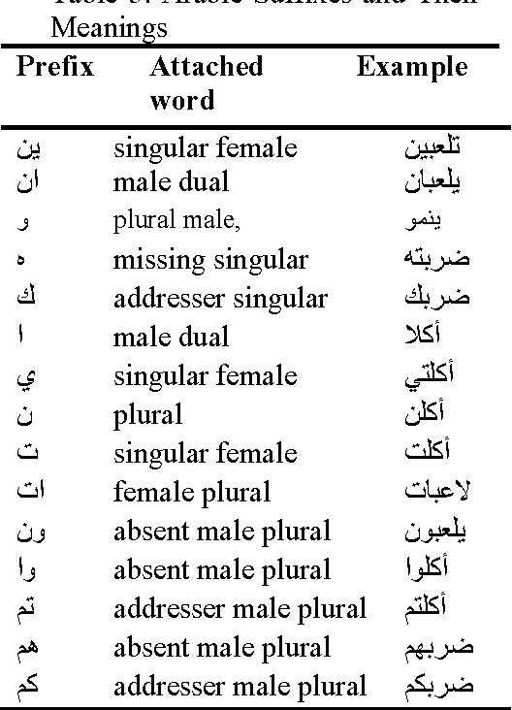
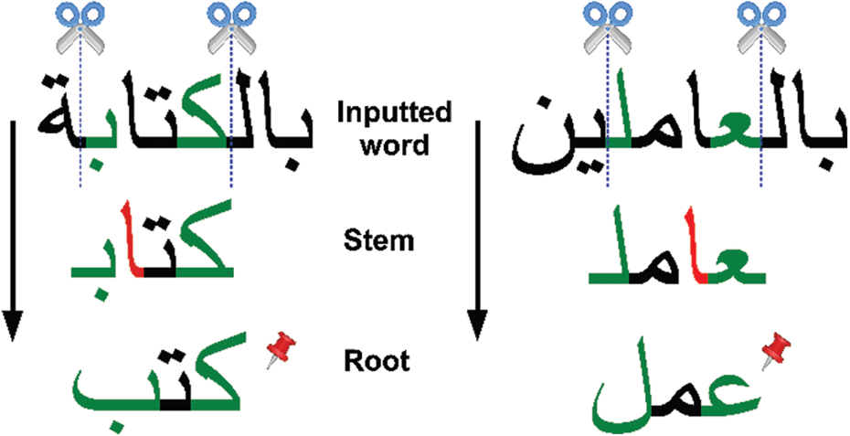
Dealing with complex morphology is necessary for Arabic languages

Slide 58
Poretr Stemmer in NLTK
nltk.download('book')
from nltk import word_tokenize
raw = """DENNIS: Listen, strange women lying in ponds distributing swords is no basis for a system of government. Supreme executive power derives from
a mandate from the masses, not from some farcical aquatic ceremony."""
tokens = word_tokenize(raw)
porter = nltk.PorterStemmer()
[porter.stem(t) for t in tokens]
['denni', ':', 'listen', ',', 'strang', 'women', 'lie', 'in', 'pond', 'distribut']

Slide 59
Sentence Segmentation
The most useful cues for segmenting a text into sentences are punctuation, like periods, question marks, and exclamation points.
.,!, ? mostly unambiguous
but period “.” is very ambiguous (U.S.A), 12.34
Between sentence boundary marker
Abbreviations like Inc. or Dr.
Numbers like .02% or 4.3
Common algorithm: Tokenize first: use rules or ML to classify a period as either (a) part of the word or (b) a sentence-boundary.
An abbreviation dictionary can help
Sentence segmentation can then often be done by rules based on this tokenization.

Slide 60
Sentence Segmentation using NLTK
text = """ My name is Ahmed. I'm thirty 30.0 years old. I live in Riyadh, K.S.A """
sents = nltk.sent_tokenize(text)
sents
[' My name is Ahmed.', "I'm thirty 30.0 years old.", 'I live in Ryiad, K.S.A']

